Slide 1
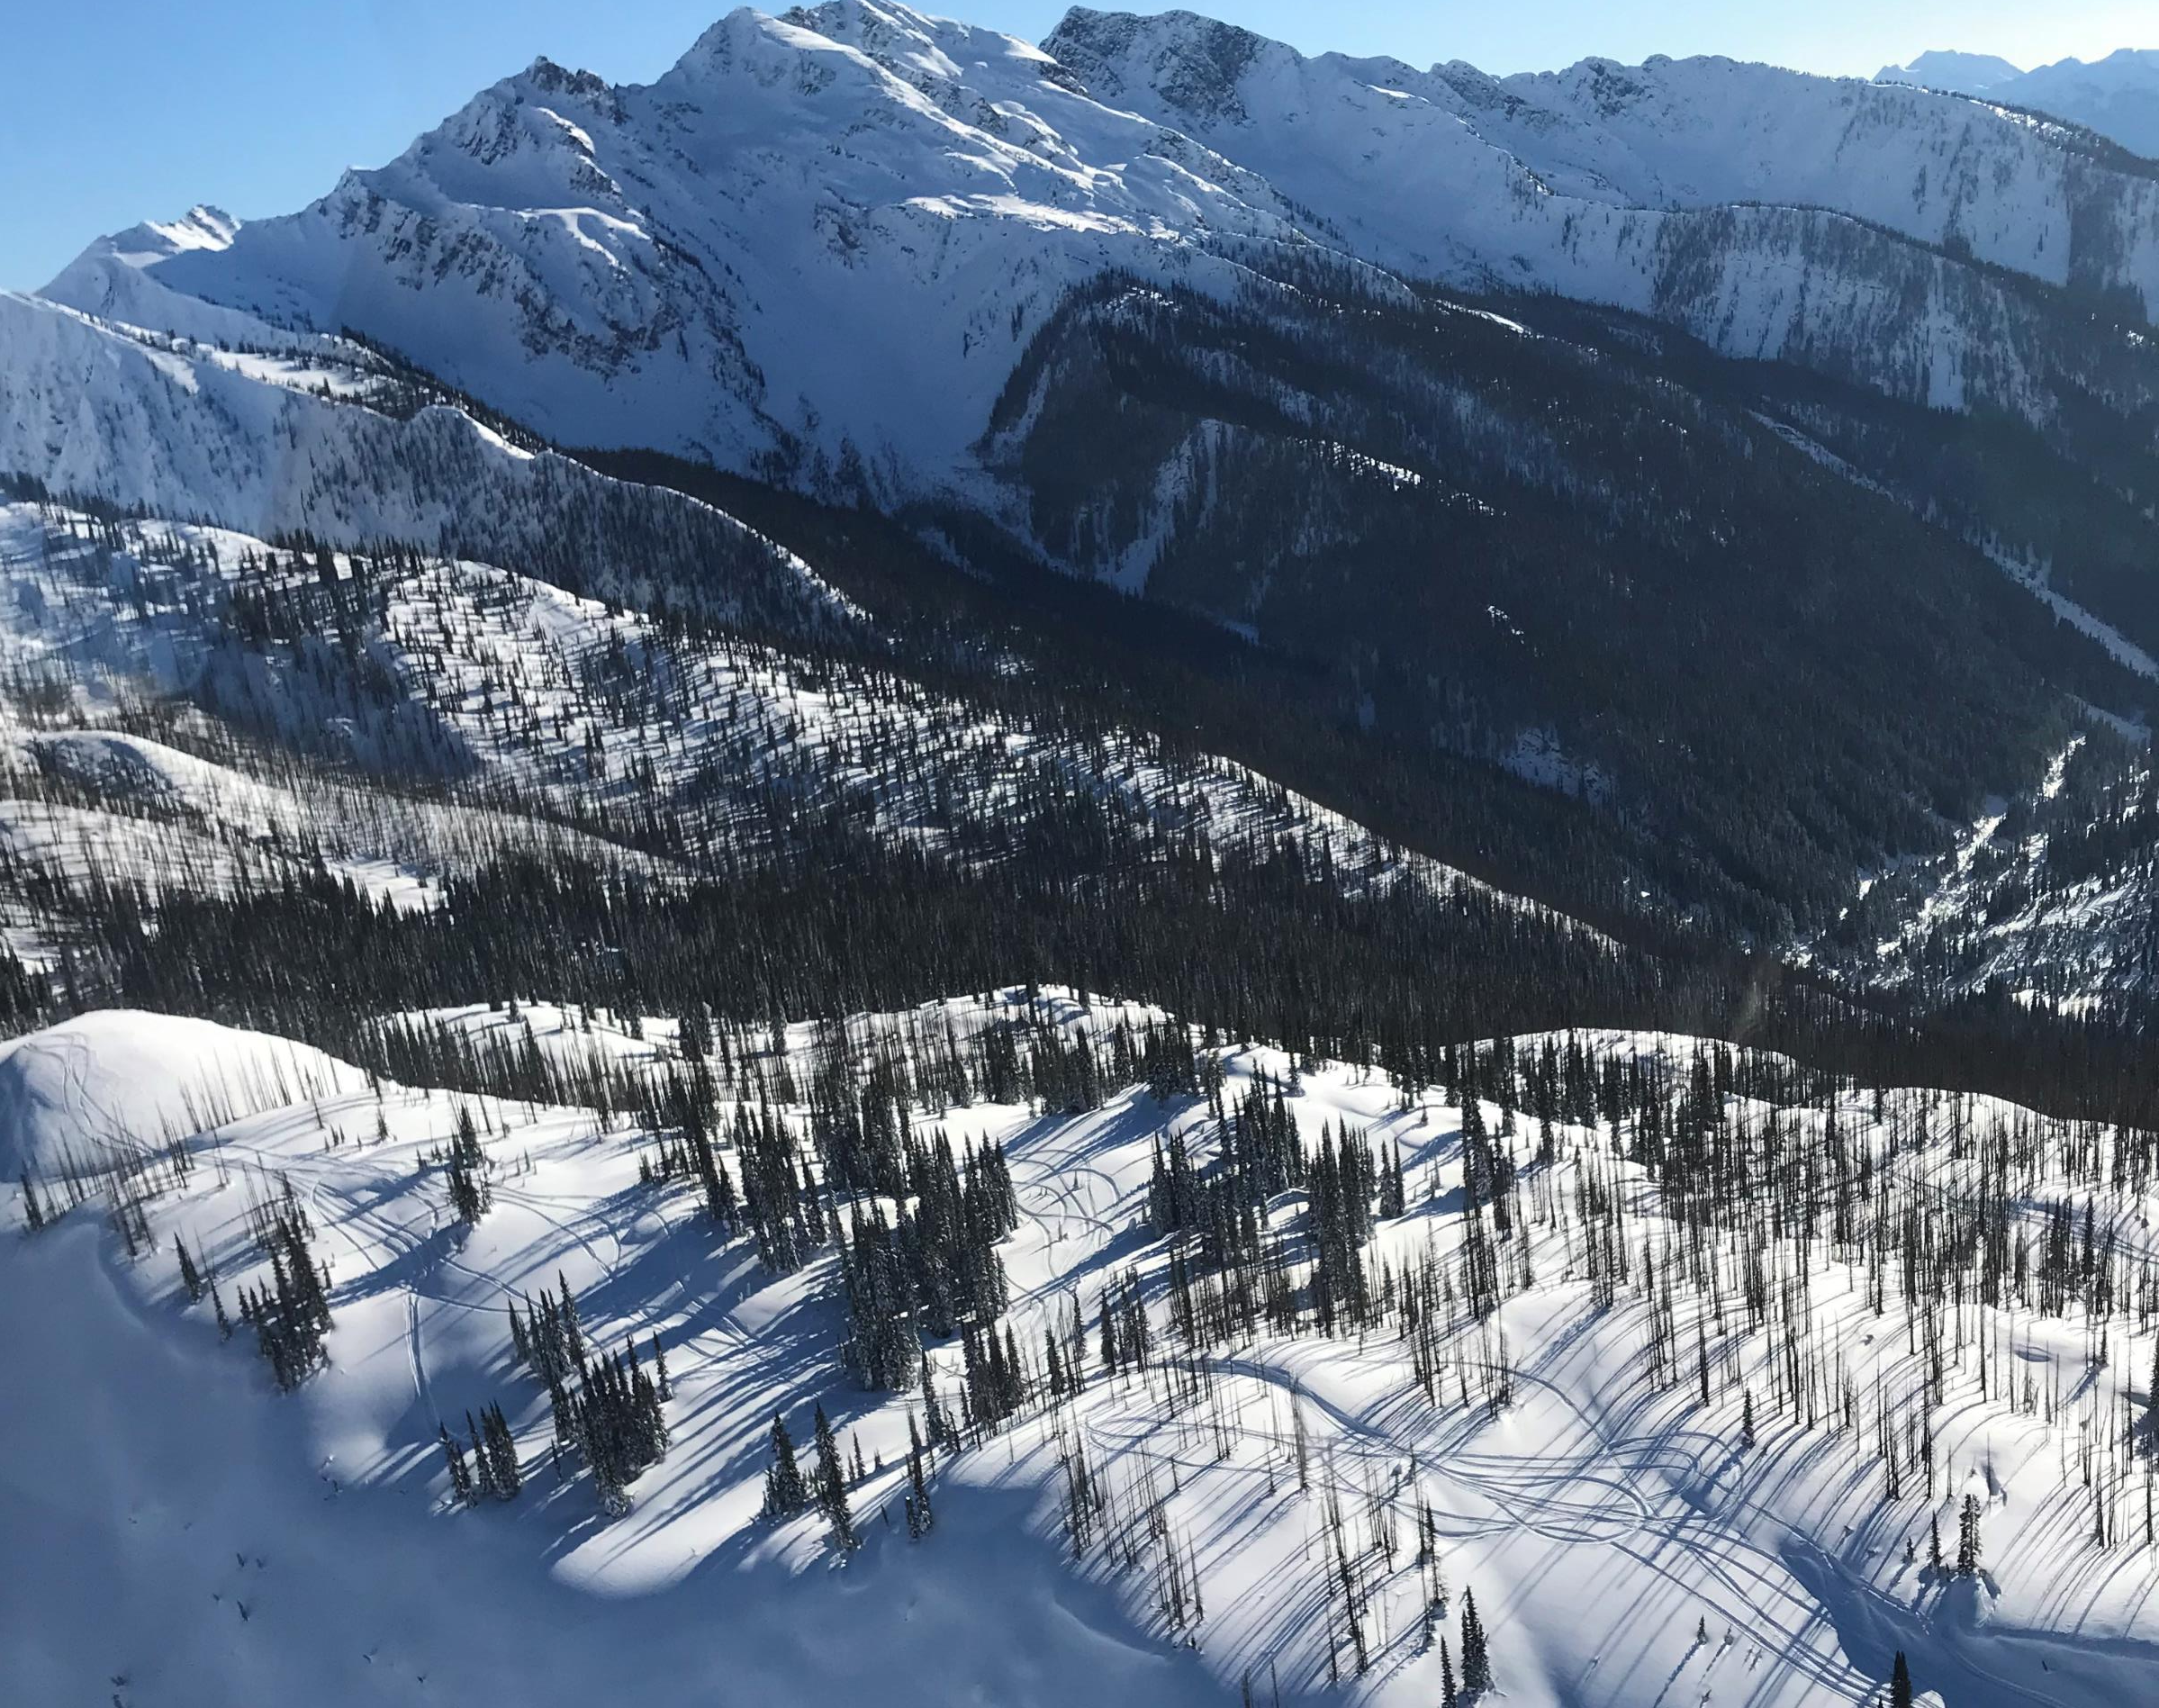
Caribou habitat objective development is about determining where resource development should not occur.
Forest Landscape Planning is about how forest management should be done in order to meet higher-level objectives.
Both processes will need to work together.
Caribou Habitat Objective and Forest Landscape Planning

Slide 2
Caribou Habitat Objective and Forest Landscape Planning
Where FLP and caribou planning overlap we need to:
- Initiate engagement on Caribou Habitat Objective first with a focus on achieving high-level agreement with First Nations on the proposed objective.
- Use a combination of FLP and caribou herd planning to determine exactly how the objective will be implemented.
.

Slide 3
Caribou Habitat Objective and Forest Landscape Planning
Where FLP and caribou planning overlap we need to:( continued )
- FLP – specific conversations on forest operations (eg – impacts of protected areas, and how to operate in matrix habitat to achieve max 35% disturbance)
- Herd Planning – discussions on other recovery measures (maternity penning, predator management, restoration).
Result will be a herd plan and a FLP, both of which described how the caribou habitat objective will be implemented on the ground.

